Slide 1

Heredity and Evolution
Reproduction (sexual and asexual)

Slide 2
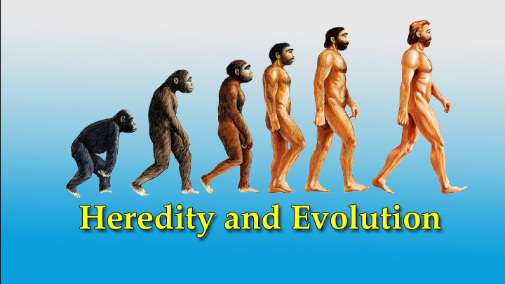

Slide 3
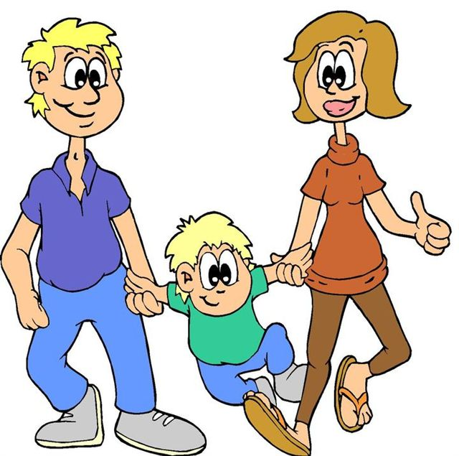

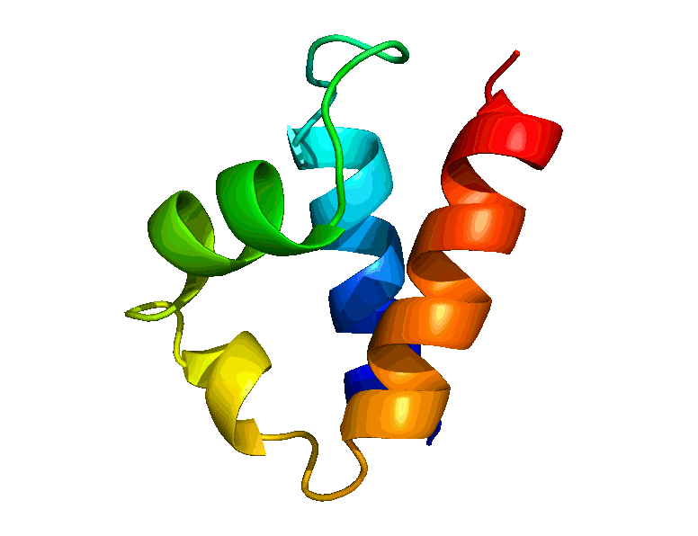

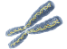
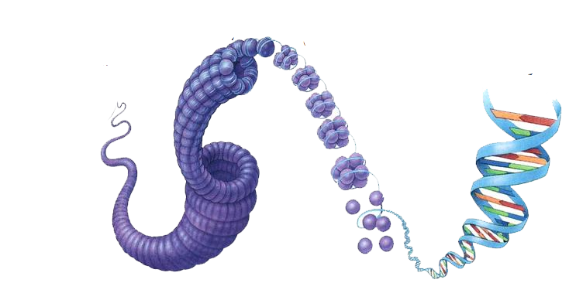
The Basic unit of life is
Protein decides the character of the body
Genes are responsible for formation of protein
Chromosomes contains DNA
Part of DNA is called as GENE
Cell
Inside the nucleus there are chromosomes
The controlling centre of the cell is nucleus

Slide 4

The Basic unit of life is
These characters are transferred from parent to offspring through reproduction

Slide 5
The Basic unit of life is
What is reproduction???

Slide 6

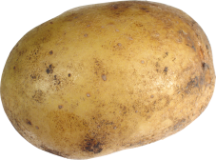
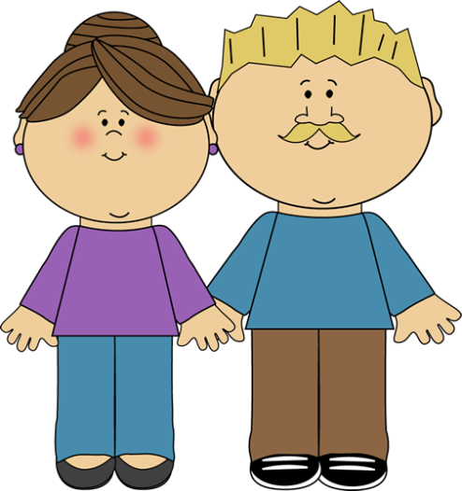
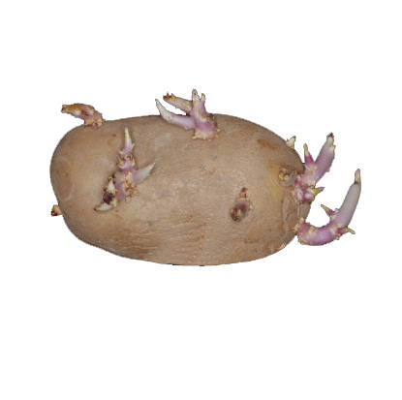
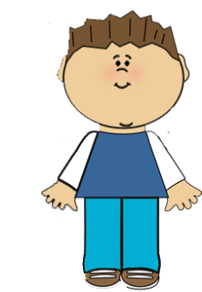
The Basic unit of life is
Reproduction
It is a process which give rise to,
Reproduction are of two types
New individuals that are similar to their parents
Sexual
Asexual
With subtle differences / variations
Two parents are involved
Only one parent involved
Minimum
Parent
Offspring
Male
Female
Offspring

Slide 7


Basic unit of life
Reproduction
Sexual
Asexual
Offspring
Offspring
Visible differences can be seen
No visible differences can be seen
Variations
Differences/Variations are maximized during sexual reproduction
Very little variations are during asexual reproduction

Slide 8
Thank You

